Slide 1
Emotional Triangles

Slide 2

What is Family Systems Theory?
Developed by Murray Bowen, M.D., aka “Bowen Theory”
Does not see behavior and events through a linear cause and effect, nor through multiple causation, but rather systemically
Focus on process, not symptoms
Seeks to modify structure rather than treat symptoms or focus on an “identified patient”
Focus on role in system, not on behavior of individuals

Slide 3
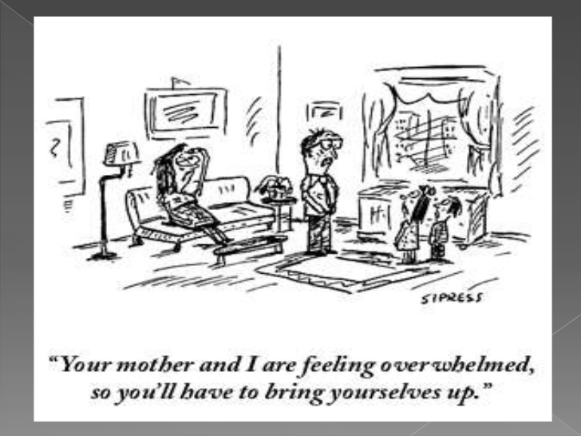

Slide 4
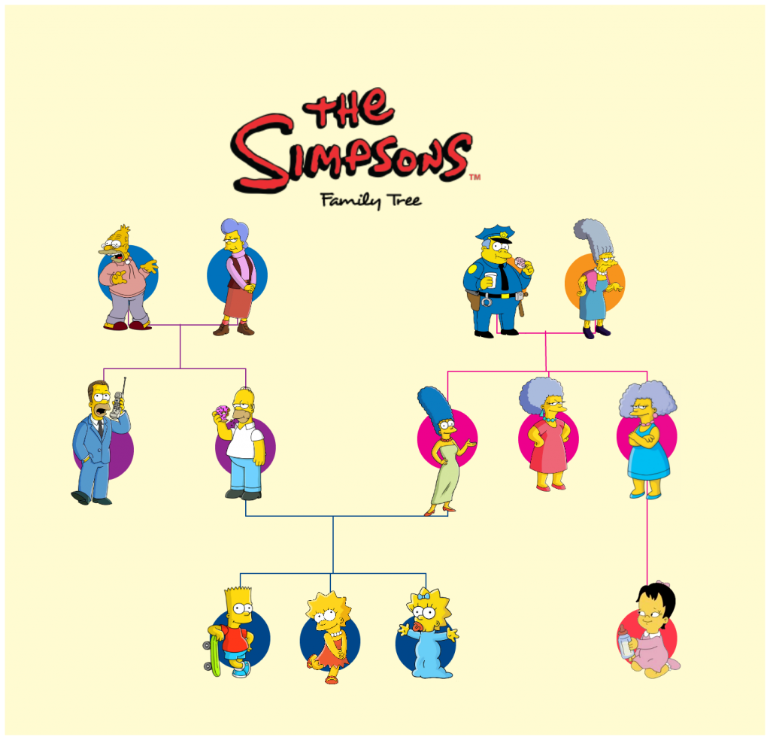
Genograms
A family diagram
Example:

Slide 5
Generational Transmission
Individual therapy tends to focus solely on parents/ Systems theory looks at the generations of family functioning.
Patterns have a way of repeating. “We can go home again,” and typically do.
Specific issues (sex, money, drinking, separation, health) are also passed on from generation to generation. Biology and Psychology are not mutually exclusive!

Slide 6
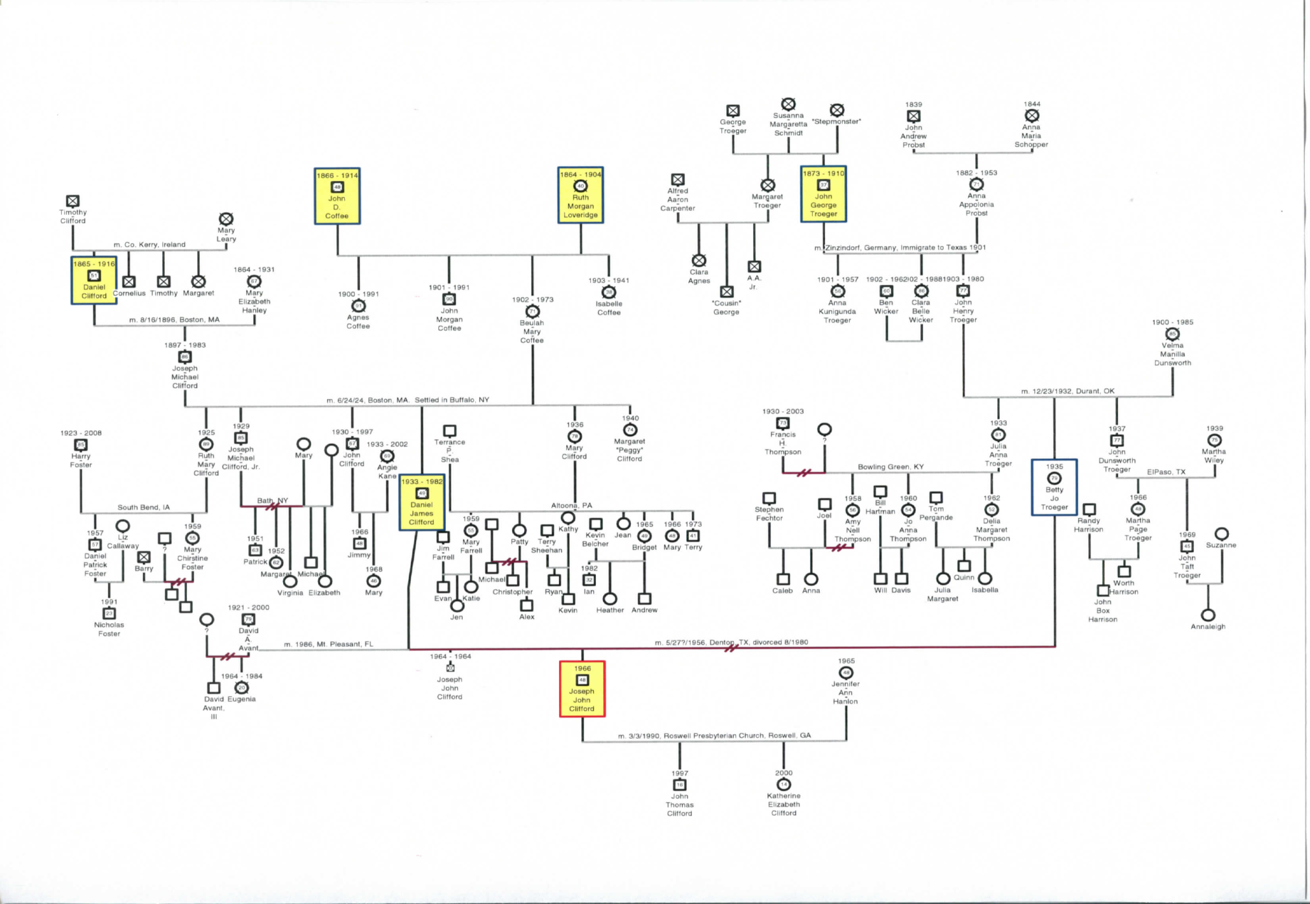

Slide 13
